Slide 1

Thursday 28th March 2019
Elsley Primary School
Learning Sharing Achieving Respecting
KS1 SATS Meeting
A presentation for parents and carers

Slide 2
What are SATS?
At the end of Key Stage 1 all children are required to be tested in different areas of Maths and English.
Throughout the year, teachers will be preparing children for these tests.
Tests inform Teacher Assessments that are submitted to the government at the end of the year.
The tests are just one part of a range of assessments which have been carried out throughout your child’s time in KS1.
Learning Sharing Achieving Respecting

Slide 3
When and how do the SATS take place?
The school is required to administer SATs throughout May, and all schools in England will be carrying out SATs at this time.
If children are absent, they will have to do the test on return to school.
We aim to make the SATs as non threatening as possible.
Learning Sharing Achieving Respecting

Slide 4
End of KS1 assessment
At the end of Year 2, children will take assessments in:
• Reading
• Maths
There is no SATs test for writing and we will not be doing the grammar and spelling SATs test.
Learning Sharing Achieving Respecting

Slide 5
KS1 Assessment Papers
The Reading Test consists of two separate papers: • Paper 1 – Contains a variety of texts with questions.
• Paper 2 – Contains a separate reading booklet.
• Children will write their answers to questions about the passage in a separate booklet.
• Children are given time to complete as much of the paper as possible
• The texts will cover a range of poetry, fiction and non-fiction.
• Questions are designed to assess the comprehension and understanding of a child’s reading.
Learning Sharing Achieving Respecting

Slide 6
Sample Paper 1
Learning Sharing Achieving Respecting

Slide 7
Sample Paper 2
Learning Sharing Achieving Respecting

Slide 8
KS1 Assessment Papers
Maths Test consists of two separate papers:
• Paper 1 is for arithmetic. It covers calculations involving addition, subtraction, division, multiplication, missing number problems and fractions.
• Paper 2 covers problem solving, reasoning and mathematical fluency. (apparatus cannot be used i.e. 100 squares etc.)
• In Paper 2, there will be a variety of question types:
Multiple choice
Matching; true/false
Constrained (e.g. completing a chart or table; drawing a shape)
Less constrained (e.g. where children have to show or explain their method).
Learning Sharing Achieving Respecting

Slide 9
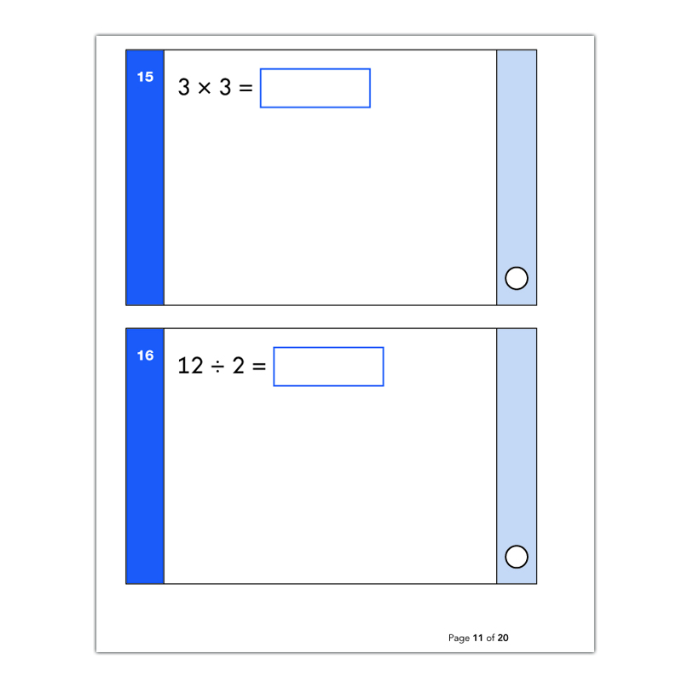
Sample Arithmetic Paper
Learning Sharing Achieving Respecting

Slide 10
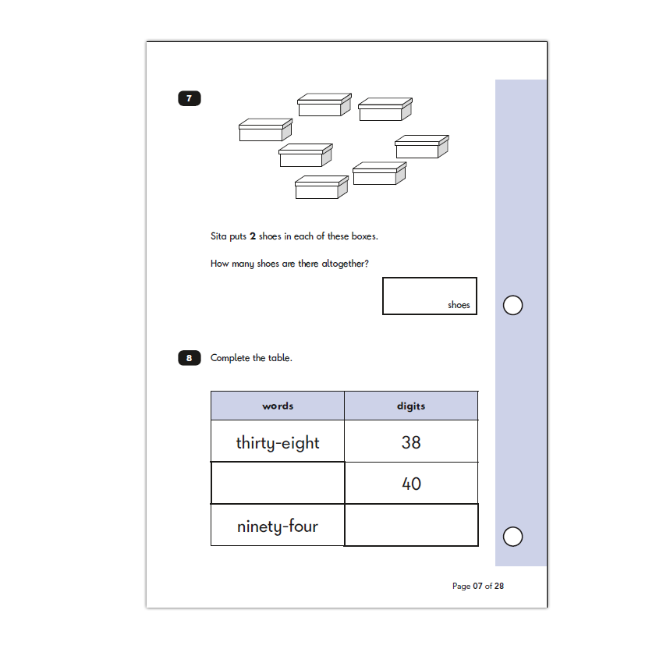
Sample Reasoning Paper
Learning Sharing Achieving Respecting

Slide 11
Teacher Assessments
The government has set an assessment criteria. Currently, in Reading, Writing and Maths children will be assessed as either:
Working towards the expected standard
Working at the expected standard
Working at ‘greater depth’.
Every aspect of assessment must be met for a child to achieve that standard.
In Science children will either be assessed as ‘working at the expected standard’ or not.
Learning Sharing Achieving Respecting

Slide 12
How can you help?
• Outstanding attendance and punctuality throughout the year
• Support at home with homework, reading, spellings, times tables
• Liaise with school if you have any issues/concerns at any point
• Support your child to understand that we all want them to do their best, but reassure them that there isn’t anything to worry about.
Learning Sharing Achieving Respecting

Slide 13
Reading: How can you help?
Listening to your child read can take many forms:
•First and foremost, focus developing an enjoyment and love of reading.
•Enjoy stories together – reading stories to your child is equally as important as listening to your child read.
•Talk about the story before, during and afterwards – discuss the plot, the characters, their feelings and actions, how it makes you feel, predict what will happen and encourage your child to have their own opinions.
•Look up definitions of words together – you could use a dictionary, the Internet or an app on a phone or tablet.
•Visit the local library - it’s free!
Learning Sharing Achieving Respecting

Slide 14
Maths: How can you help?
Play times tables games.
Play mental maths games including counting in different amounts, forwards and backwards.
Encourage opportunities for telling the time.
Encourage opportunities for counting coins and money e.g. finding amounts or calculating change when shopping.
Look for numbers on street signs, car registrations and anywhere else.
Look for examples of 2D and 3D shapes around the home.
Identify, weigh or measure quantities and amounts in the kitchen or in recipes.
Play games involving numbers or logic, such as dominoes, card games, draughts or chess.
Learning Sharing Achieving Respecting

Slide 15
Useful Websites
BBC – KS1 Bitesize – Literacy http://www.bbc.co.uk/bitesize/ks1/literacy
Reading Comprehension Worksheets
http://www.superteacherworksheets.com/2nd-comprehension.html
Sample Papers
https://www.gov.uk/government/collections/national-curriculum-assessments-practice-materials
Learning Sharing Achieving Respecting

Slide 16
Questions
We hope this will give you an idea of what the SATs involve.
If you have any questions, please do not hesitate to ask any member of staff.
Thank you for coming!
Learning Sharing Achieving Respecting

